Slide 1
U.S. Virgin Islands Economic Development Authority
Webinar: Maximizing PPP Loan Forgiveness
Moderator: Cusa Holloway, USVIEDA Incubator Program Manager
July 29, 2020
10:00 AM AST

Slide 2
Agenda
VI Small Business Development Center (SBDC)
Technical Assistance
Small Business Administration (SBA)
VIEDA’s Economic Development Bank (EDB)

Slide 3
Speakers
Ted Gutierrez
State Director
VI Small Business Development Center
Wayne Huddleston
Senior Area Manager
Small Business Administration
Monique Samuel
Acting Director of Lending
Economic Development Bank
Facebook
Instagram
Twitter
626 Followers
280 Followers
476 Followers
3

Slide 4
How to Maximize PPP Loan Forgiveness
Puerto Rico & U.S. Virgin Islands District Office

Slide 5
By the Numbers Covid Loan Participation in the US Virgin Islands
Nationwide Paycheck Protection Program PPP Numbers: as of July 24, 2020
5,005,261 PPP loans approved valued at $519,505,881,228.
$130,096,258,496 in PPP funding remaining
Average loan size nationwide is about $104,000.
USVI (PPP): as of July 24, 2020
1,931 approved loans for $124,758,065
Accessible to August 8, 2020
Nationwide Economic Injury Disaster Loan (EIDL) Numbers: as of July 14, 2020
5,781,390 advances disbursed for $20,000,000,000
2,622,203 EIDL loans approved for $150,177,958,290
USVI (EIDL): as of July 14, 2020
1,829 Advances disbursed valued at $6,507,000
1,315 loans approved for $76,253,400

Slide 6
Coronavirus Disaster Funding Options https://www.sba.gov/funding-programs/loans/coronavirus-relief-options
Paycheck Protection Program
Available through August 8, 2020
Eligible to businesses that have been operating since at least February 15, 2020
Loan Amount: Up to $10 million (fixed formula: average annual payroll / 12 x 2.5)
Loan payments:
Deferred for 10 months
Repayment term: up to 5 years
Designated Uses and pre-requisites for forgiveness:
Payroll: minimum 60%
Other Expenses: (Rent, Utilities, Mortgage Interest): up to a maximum of 40%)
No collateral or personal guarantees required.
Interest rate: 1%
SBA Will Open #PPP Loan Forgiveness Platform August 10, 2020

Slide 7
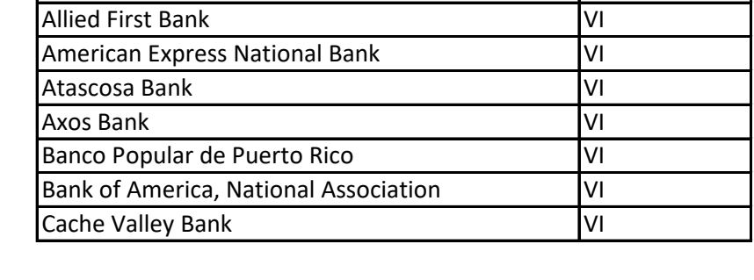
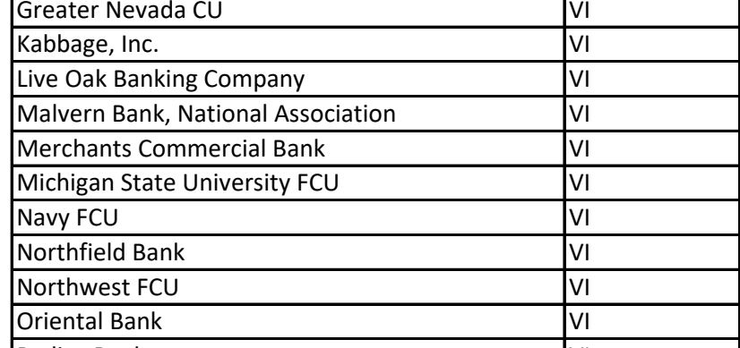
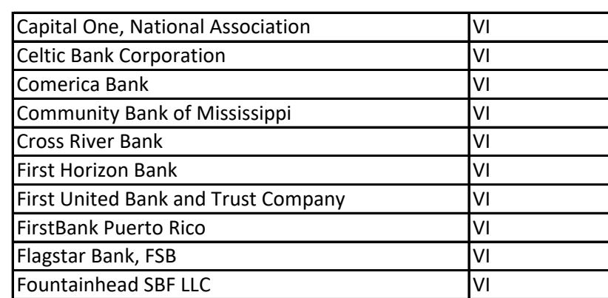
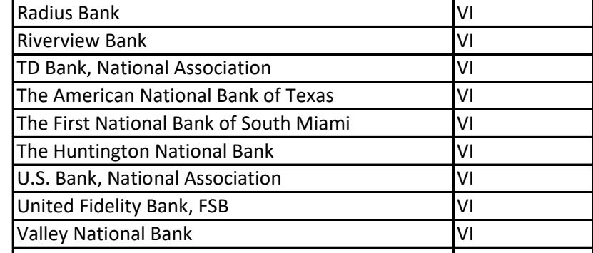
Lenders who have approved PPP Loans in the US Virgin Islands

Slide 8
What is the general process to obtain loan forgiveness?
BORROWER | LENDER | SBA
1. Complete and submit the Loan Forgiveness Application (SBA Form 3508, 3508EZ, or lender equivalent) to its lender | 2. Review the application and make a decision regarding loan forgiveness: Approval (in whole or in part) Denial Denial without prejudice (due to pending SBA review)
 | 3. Has 60 days from receipt of a complete application to issue a decision to SBA.
 | 4. If lender determines that the borrower is entitled to forgiveness of some or all of the amount applied for, the lender must request payment from SBA at the time the lender issues its decision to SBA. | 5. SBA will, subject to any SBA review of the loan or loan application, remit the appropriate forgiveness amount to the lender, plus any interest accrued through the date of payment, not later than 90 days after the lender issues its decision to SBA.
 |  | 6. If applicable, SBA will deduct EIDL Advance Amounts from the forgiveness amount remitted to the Lender.
 |  | 7. If SBA determines that the borrower was ineligible for the PPP loan, the loan will not be eligible for loan forgiveness.
 | 8. The lender is responsible for notifying the borrower of the forgiveness amount.
 | 9. The lender is responsible for notifying the borrower Of forgiveness amount paid by SBA If Lender or SBA reduces forgiveness If Lender or SBA denies application If applicable: Remaining balance due & first payment due date
10. If only a portion of the loan is forgiven, or if the forgiveness request is denied, any remaining balance due on the loan must be repaid by the borrower on or before the maturity date of the loan. | 11. If SBA determines that the full amount of the loan is eligible for forgiveness and remits the full amount of the loan to the lender, the lender must mark the PPP loan note as “paid in full”.

Slide 9
Applying for PPP Loan Forgiveness www.sba.gov/ppp under Loan Details and Forgiveness
Question: What form is to be used for PPP Forgiveness Application?
Answer: Revised Loan Forgiveness Application Form 3508
Question: Who can use the SBA Form 3508EZ forgiveness application?
Answer: (Form 3508EZ instructions, page 1)
Self-employed borrower with no employees that did not include any salaries in the calculation of their average monthly payroll (when determining their eligible loan amount); or
Borrower didn’t reduce wages by more than 25% and didn’t reduce number of employees or average paid hours of employees (or wasn’t able to rehire/hire similarly qualified employees); or
Borrower didn’t reduce wages by more than 25% and was unable to operate at the same level of activity due to government restrictions

Slide 10
FAQ
Question:
May a borrower submit a forgiveness application before the end of their covered period?
Answer:
Yes, if the borrower has used all the loan proceeds for which it is requesting forgiveness.
If borrower reduced salary by more than 25%, borrower must account for the reduction for the full covered period

Slide 11
FAQ
Question: What documentation does the borrower submit to the Lender with its forgiveness application?
Answer:
Forgiveness Application Form (SBA Form 3508 or 3508EZ) and:
Generally – (See Forms 3508/3508EZ for specific details)
Payroll: Proof of payment - Documentation verifying the eligible cash compensation and non-cash benefit payments (bank account statements, tax forms, payment receipts, cancelled checks, account statements); and
Nonpayroll: Proof of obligation and proof of payment - Documentation verifying existence of the obligations/services prior to Feb. 15, 2020 and payments (copy of lender amortization schedule, lease, utility invoices; copies of cancelled checks; and
For 3508 only: PPP Loan Forgiveness Calculation Form; PPP Schedule A; Documentation showing average number of FTE employees on payroll during referenced time periods

Slide 12
FAQ
Question:
What documentation must be maintained by borrower but is not submitted unless requested?
Answer:
Both Forms 3508 & 3508EZ: All records and supporting documentation
Form 3508: PPP Schedule A Worksheet and documentation supporting the entries on the Worksheet (each employee and pay; documentation supporting any of the “Safe Harbors”
See Forms 3508/3508EZ for specific details

Slide 13
Loan Forgiveness Process
If Lender denies the borrower’s application in full:
Lender must notify borrower in writing
If Borrower wants SBA to review:
Must notify Lender within 30 days
Lender must notify SBA within 5 days
SBA reserves the right to review in its sole discretion and will notify Lender if SBA declines review request

Slide 14
SBA Resources and Links
For EIDL Loan Applicants:
1-800-659-2955
disastercustomerassistance@sba.gov
www.sba.gov/funding-programs/disaster-assistance
SBA PR & USVI Office:
1-787-523-7120
wayne.huddleston@sba.gov
lisa.chamely-aqui@sba.gov
https://www.sba.gov/pr
PPP Forgiveness Guidance
Most Recent:
home.treasury.gov/policy-issues/cares/assistance-for-small-businesses
PPP Related Content including
Forgiveness Applications:
sba.gov/fundingprograms/loans/coronavirus-relief-options/paycheck-protection-program
All Interim Final Rules
Borrower Application Form
Loan Forgiveness Instructions and Application Form
FAQ for Lenders and Borrowers
PPP Loan Activity by State
Information on Traditional SBA Lending Options
For local technical assistance for individual USVI businesses:
www.visbdc.org
https://www.score.org/
Free business mentoring and education
For information on all federal programs:
www.usa.gov/coronavirus

Slide 15
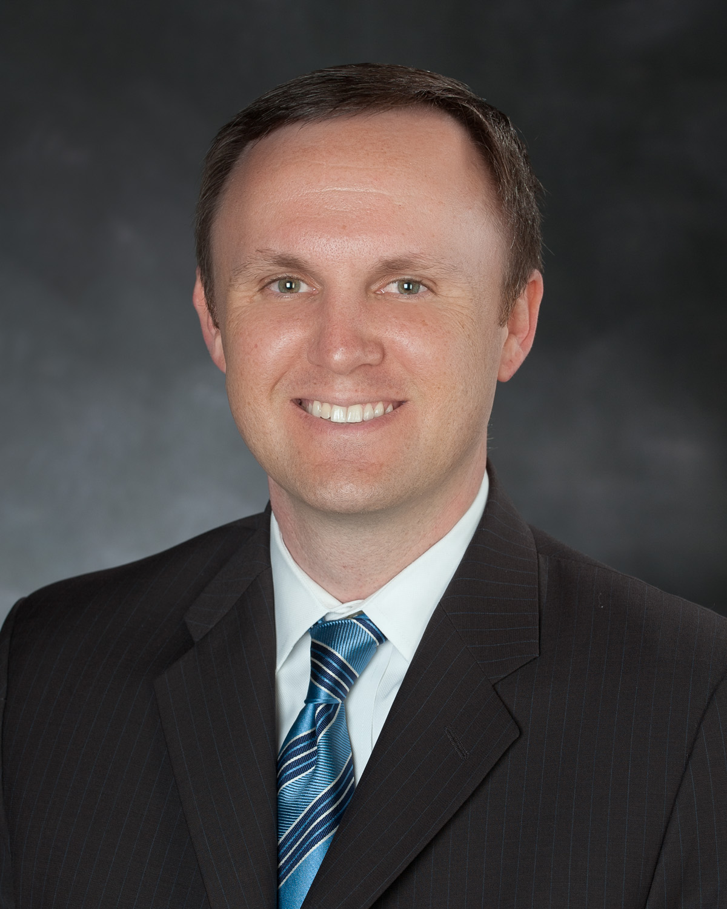
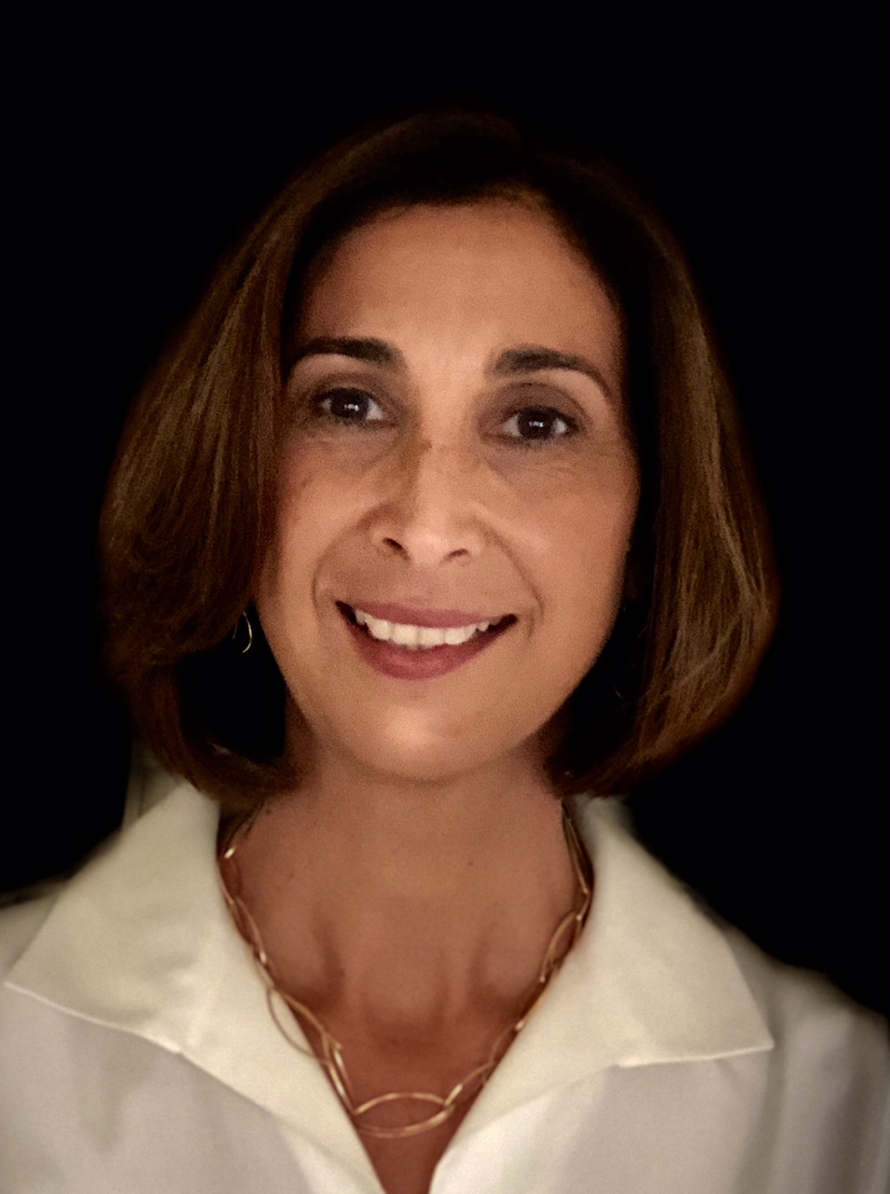
USVI Local Assistance
SBA Puerto Rico & U.S. Virgin Islands District Office https://www.sba.gov/pr
U.S. Virgin Islands – (340) 473-7945
Puerto Rico – (787) 766-5002 / 5003
https://twitter.com/SBA_PuertoRico
Helping Businesses Grow & Succeed
Virgin Islands Small Business Development Center
http://www.visbdc.org
Consulting, Workshops & Technical Assistance.
Currently accepting virtual appointments.
St. Thomas/St. John
8000 Nisky Center, Suite 720
St. Thomas VI 00802
(340) 693-1694
St. Croix 6300 Estate Peters Rest #4
Christiansted, St. Croix VI 00820
(340) 692-4294
info@visbdc.org
Wayne Huddleston Senior Area Manager – U.S. Virgin Islands Puerto Rico & U.S. Virgin Islands District Office U.S. Small Business Administration O: (787) 523-7120 Cell (340) 473-7945 wayne.huddleston@sba.gov

Slide 16
Thank you for your attention
QUESTIONS
?

Slide 17
VIRGIN ISLANDS SMALL BUSINESS DEVELOPMENT CENTER
How does the VI SBDC assist small businesses?
Provide objective technical assistance to small businesses affected by COVID-19
Promote COVID-19 Federal Funding programs
Assist clients understand the application process
Answer questions about these and other programs
Assist clients through telephone, email, video-conferences
Collaborate with local partners
Providing assistance for Federal Funding forgiveness processes
COVID-19 resource tab on VI SBDC website
Funded in part through a cooperative agreement with the U.S. Small Business Administration

Slide 18
VIRGIN ISLANDS SMALL BUSINESS DEVELOPMENT CENTER
St Thomas/ St John: 340-693-1694
St Croix: 340-692-4294
Email: info@visbdc.org
Website: www.visbdc.org
facebook.com/visbdc
@visbdc
youtube.com/visbdc
Funded in part through a cooperative agreement with the U.S. Small Business Administration

Slide 19
Paycheck Protection Program Flexibility Act of 2020
Presented by The Economic Development Bank for the United States Virgin Islands
a subsidiary entity of the
Virgin Islands Economic Development Authority

Slide 20
Economic Development Bank (EDB) Overview
The Government Development Bank (GDB) and Small Business Development Agency (SBDA) provides technical support, business counseling and guidance to small businesses in USVI. In May 2014, The Economic Development Bank for the United States Virgin Islands (EDB) was enacted by law to assume the functions of these two entities.
The EDB provides loans to existing and start-up businesses thereby creating and maintaining jobs in the territory and is responsible for the credit administration of its loan portfolio.

Slide 21
Paycheck Protection Program (PPP)
Online Application Portal
Visit: www.usvieda.org

Slide 22
Thank you to the SBA and VISBDC for participating in this webibar!
We Support Small Business!
Q&A
For more information contact: info@usvieda.org
St. Croix: (340) 773-6499 or St. Thomas/St. John: (340) 714-1700
The recording & slide deck will be available at: www.usvieda.org/webinars
@usvieda
@visbdc
@usvi_eda
@visbdc

