Slide 1
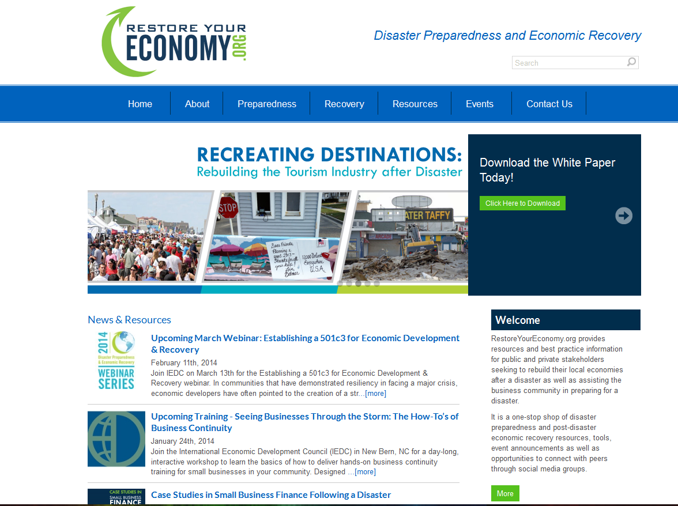
Where to find additional ideas and case studies
www.RestoreYourEconomy.org
More than 50 free recorded webinars
Best practice case studies, research reports, helpful videos, links

Slide 2
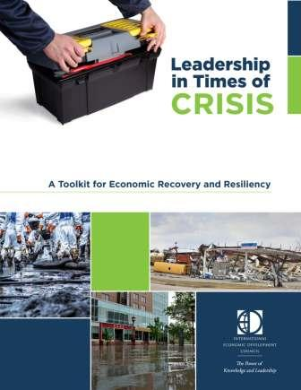
Toolkit for Economic Recovery & Resiliency Available free on www.RestoreYourEconomy.org

Slide 3
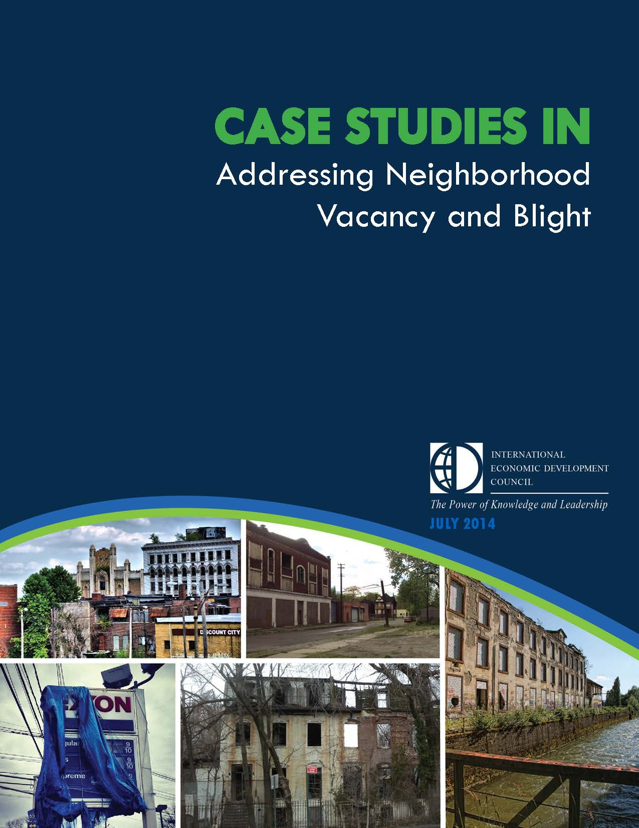
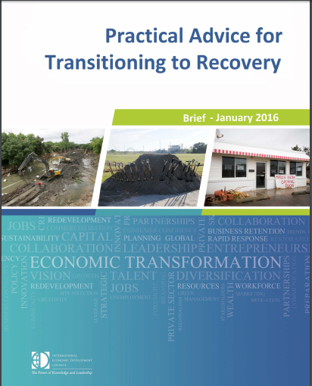
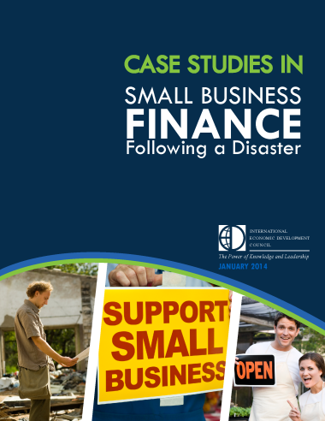
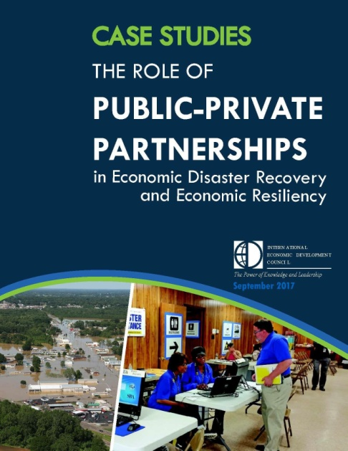
Quick read papers & brochures for download
Updated in 2018
Notes:
Case Studies in Vacancy & Blight
Strategies for recovering blighted areas
Case Studies on Post-Disaster Small Business Finance Programs
6 case studies on how communities have utilized a mix of public and private funding to aid small businesses
How to use Public-Private Partnerships in Economic Recovery

Slide 4
Thoughts on economic recovery and resilience leadership
When you think that you have little capacity to carry through a situation, please know that
“Your recovery team is bigger than you realize: federal and state partners, public and private resources, volunteers with expertise.”
Every community is unique, but there is a “playbook” for disaster recovery and there are certain best practices we can help you with.
Resilience thinking must become a core value, because any disaster that happens once can happen again.
Comprehensive planning and follow through will define the risks and vision for resilience.
Financing remains a critical need for long-term recovery, but this can be leveraged through public-private partnerships, federal assistance, volunteer work and donations.

Slide 5
Resilience in Economic Development Planning was published by the U.S. Economic Development Administration (EDA) with assistance from the Federal Emergency Management Agency (FEMA) https://www.eda.gov/files/about/disaster-recovery/EDA_CO-Economic-Resilience-Planning_Oct2014.pdf For more resources to support recovery and resilience following economic disruptions, visit the US Economic Development Administration's Disaster Recovery pages at: https://www.eda.gov/programs/disaster-recovery/

Slide 6
Economic recovery and mitigation
National Association of Development Organizations (NADO) Research Foundation has resources for building mitigation strategies into economic development plans, highlighting data, analysis and metrics to consider:
Resilient Regions: Integrating Economic Development Strategies, Sustainability Principles, and Hazard Mitigation Planning
Building Economic Resilience in the Kerr-Tar Region: Recommendations for Linking Comprehensive Economic Development Strategies and Hazard Mitigation Plans.
Excerpt from Measurement Section:

Slide 7
Decision making Tools for economic resilience and Diversification
The following tools support decision making for economic diversification, to reduce reliance on sectors that are particularly vulnerable to hazards and change:
Triple Bottom Line (Portland Statue University)
Provides information on the broad economic, social, and environmental impacts development decisions that can support informed decision making.
Investment Analysis (Purdue University & Indiana Business Research Center)
Tools to assist practitioners in prioritizing projects.
EDGe$ Tool (National Institute of Standards and Technologies)
Software-based technique for selecting cost-effective community resilience projects based on the process found in the Community Resilience Economic Decision Guide for Buildings and Infrastructure Systems.

Slide 8
Economic resilience of key sectors
Industry Sector-Specific Guides provide frameworks for business continuity planning, hazard mitigation, insurance and related resilience considerations:
Leisure, Hospitality, and Retail Services (PDF)
Biotechnology, Pharmaceuticals, and Life Sciences (PDF)
Advanced Manufacturing (PDF)
Health Care (PDF)
Financial Services (PDF)
Information Technology (PDF)
Transportation, Logistics, and Distribution (PDF)
https://www.eda.gov/programs/disaster-recovery/

Slide 9
Finally
Data, strategies and case studies for aligning smart growth with disaster mitigation and resilience plans are also available:
National Institute of Building Sciences (FEMA and EDA)
Multi-hazard Mitigation Council’s Natural Hazard Mitigation Saves 2017 Interim Report
National Oceans and Atmospheric Administration (NOAA)
https://coastalsmartgrowth.noaa.gov/resilience.html
US Environmental Protection Agency (EPA)
https://www.epa.gov/smartgrowth/smart-growth-strategies-disaster-resilience-and-recovery

Slide 10
Contact info for federal representatives that participated in US Virgin Islands workshops:
Elsa Alvear, US Department of the Interior, National Parks Services, elsa_alvear@nps.gov
Michael Fesko, Public Health Analyst, US Department of Health and Human Services, Federal Drug Administration, michael.fesko@fda.gov
Rick Florence, US Department of Agriculture, rick.Florence@tx.usda.gov
Jessie Huddleston, Community Planner, FEMA, jessie.huddleston@fema.dhs.gov
Wayne Huddleston, Senior Area Manager for USVI, US Small Business Administration, Charles.huddleston@sba.gov
Beth Gratzer, Community Planner, FEMA, beth.gratzer@fema.dhs.gov
Nancy Gilbert, US Department of Commerce, Economic Development Administration, ngilbert@eda.gov

Slide 11
Contact info for federal representatives that participated in US Virgin Islands workshops:
Scott Jackson, US Department of Commerce, National Telecommunications and Information Administration (NTIA), sjackson@ntia.doc.gov
Ken Rathje, Federal Disaster Recovery Coordinator, FEMA, Kenneth.rathje@fema.dhs.gov
Pam Swingle, Sustainability Advisor, US Environmental Protection Agency, swingle.pamela@epa.gov
Steve Wade, Federal Disaster Recovery Officer, FEMA, Stephen.wade@fema.dhs.gov
Mark Wolfe, US Army Corps of Engineers, Mark.E.Wolff@usace.army.mil

Slide 12
THANK YOU to the following USVI Agencies and Organizations that participated in these workshops!
Community Foundation of the Virgin Islands
Downtown Revitalization Inc. (Charlotte Amalie)
St Croix Foundation for Community Development
St Thomas – St John Chamber of Commerce
United Steelworkers Local
University of the Virgin Islands
VI Bureau of Economic Research
VI Department of Education
VI Department of Finance
VI Department of Planning & Natural Resources
VI Department of Tourism
VI Economic Development Authority
VI Housing Finance Authority
VI Next Generation Network
VI Office of Management & Budget
VI Small Business Development Center
VI Workforce Development Board
USVI Hurricane Recovery and Resiliency Task Force
West Indian Company

